Slide 1


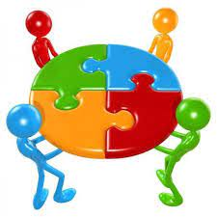
DIVERSE WORKFORCE
UNIT 4

Slide 2
LEARNING OUTCOMES
Define workplace diversity and explain why managing it is so important
Describe the changing workplaces in the United States and around the world
Explain the different types of diversity found in workplaces
Discuss the challenges managers face in managing diversity
Describe various workplace diversity management initiatives

Slide 3

WHAT IS WORKPLACE DIVERSITY?
Workforce Diversity - the ways in which people in an organization are different from and similar to one another.
Notes:
Diversity has been “one of the most popular business topics over the last two decades. It ranks with modern business disciplines such as quality, leadership, and ethics. Despite this popularity, it’s also one of the most controversial and least understood topics. With its basis in civil rights legislation and social justice, the word diversity often invokes a variety of attitudes and emotional responses in people.
So, what’s our definition of workplace diversity? We’re defining it as the ways in which people in an organization are different from and similar to one another. Notice that our definition not only focuses on the differences, but the similarities, of employees. This reinforces our belief that managers and organizations should view employees as having qualities in common as well as differences that separate them.

Slide 4
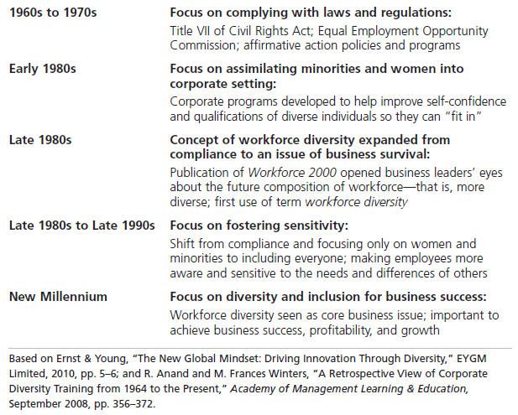
EXHIBIT 4-1 TIMELINE OF THE EVOLUTION OF WORKFORCE DIVERSITY
Notes:
Diversity has traditionally been considered a term used by human resources departments, associated with fair hiring practices, discrimination, and inequality. But diversity today is considered to be so much more. Exhibit 4-1 illustrates an historical overview of how the concept and meaning of workforce diversity has evolved.

Slide 5
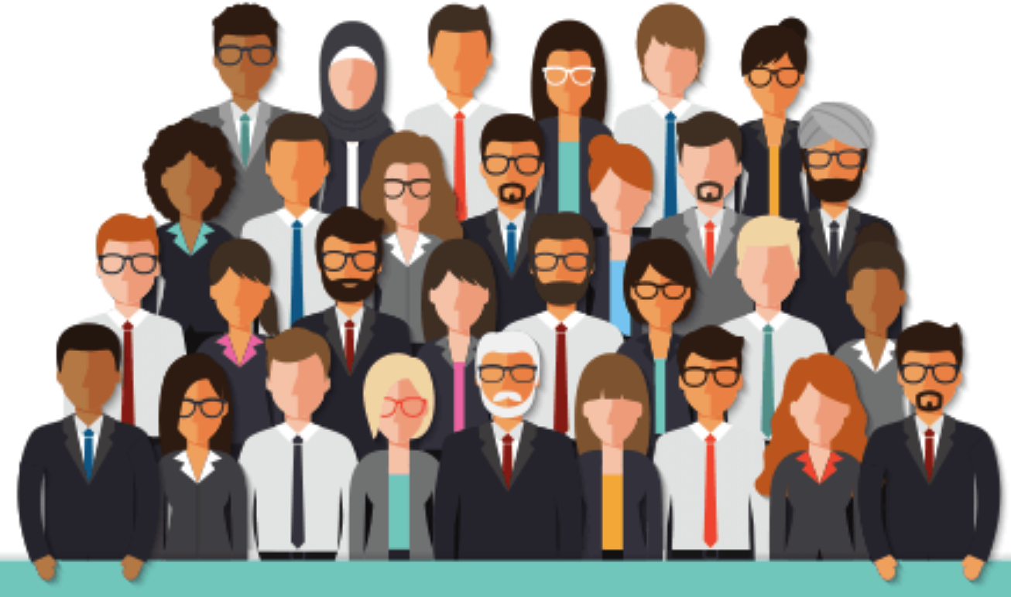
TYPES OF WORKPLACE DIVERSITY
Surface-level diversity-
Easily perceived differences that may trigger certain stereotypes, but do not necessarily reflect the ways people think or feel.
Deep-level diversity -
Differences in values, personality, and work preferences.
Notes:
The demographic characteristics that we tend to think of when we think of diversity—age, race, gender, ethnicity, and so on—are just the tip of the iceberg. These demographic differences reflect surface-level diversity, which are easily perceived differences that may trigger certain stereotypes but that do not necessarily reflect the ways people think or feel. Such surface-level differences in characteristics can affect the way people perceive others, especially when it comes to assumptions or stereotyping.
As people get to know one another, these surface-level differences become less important and deep-level diversity—differences in values, personality, and work preferences—becomes more important. These deep-level differences can affect the way people view organizational work rewards, communicate, react to leaders, negotiate, and generally behave at work.

Slide 6
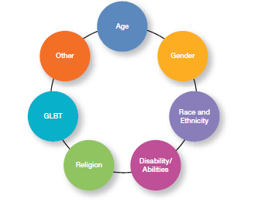
EXHIBIT 4-5 TYPES OF DIVERSITY FOUND IN WORKPLACES
Notes:
Diversity is a big issue, and an important issue, in today’s workplaces. What types of dissimilarities—that is, diversity—do we find in those workplaces? Exhibit 4-5 shows several types of workplace diversity.

Slide 7
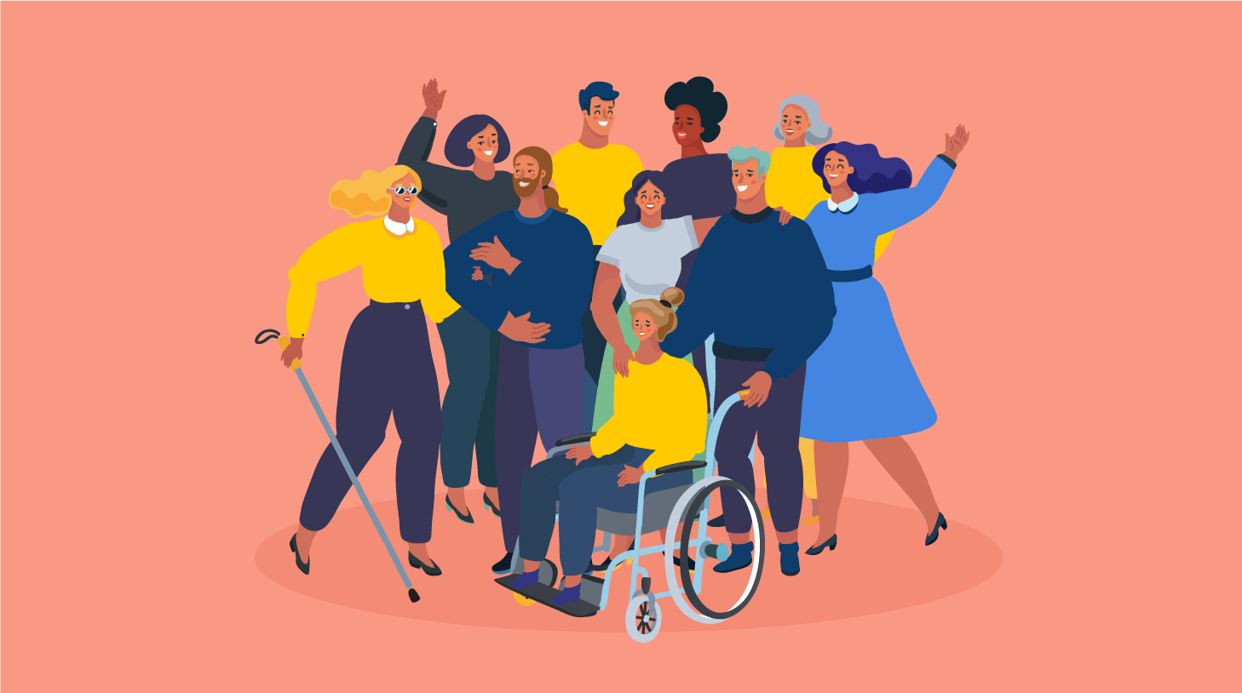
TYPES OF WORKPLACE DIVERSITY
Age - Both Title VII of the Civil Rights Act of 1964 and the Age Discrimination in Employment Act of 1967 prohibit age discrimination.
Gender - Women (49.8%) and men (50.2%) now each make up almost half of the workforce.
Notes:
The aging population is a major critical shift taking place in the workforce. With many of the nearly 85 million baby boomers still employed and active in the workforce, managers must ensure that those employees are not discriminated against because of age. Both Title VII of the Civil Rights Act of 1964 and the Age Discrimination in Employment Act of 1967 prohibit age discrimination.
Women (49.8%) and men (50.2%) now each make up almost half of the workforce. Yet, gender diversity issues are still quite prevalent in organizations. Take the gender pay gap. The latest information on the ratio of women’s to men’s median weekly earnings showed the figure at 80.2; the ratio for median annual earnings stood at 77.1. It’s important for organizations to explore the strengths that both women and men bring to an organization and the barriers they face in contributing fully to organizational efforts. And, it’s important to note that many companies are “grooming more women for the corner office.” In fact, recent research by McKinsey & Co found that 24 percent of senior vice .presidents at 58 big companies are women

Slide 8

TYPES OF WORKPLACE DIVERSITY (CONT.)
Race - The biological heritage (including skin color and associated traits) that people use to identify themselves
Ethnicity - Social traits (such as cultural background or allegiance) that are shared by a human population
Notes:
Race and ethnicity are important types of diversity in organizations. We define race as the biological heritage (including physical characteristics such as one’s skin color and associated traits) that people use to identify themselves. Most people identify themselves as part of a racial group. Such racial classifications are an integral part of a country’s cultural, social, and legal environments.
Ethnicity is related to race, but it refers to social traits—such as one’s cultural background or allegiance—that are shared by a human population

Slide 9

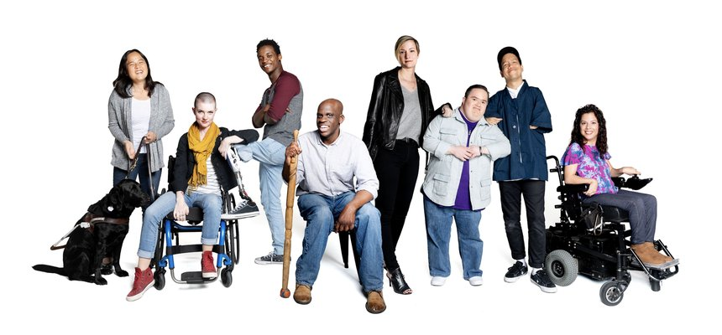
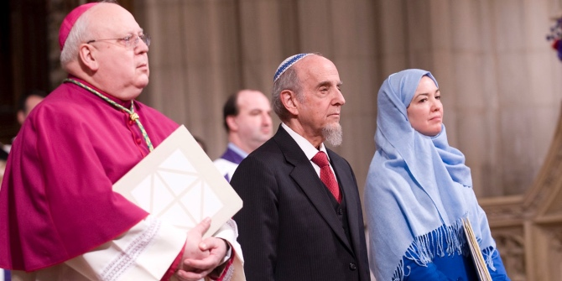
TYPES OF WORKPLACE DIVERSITY (CONT.)
Disability/Abilities - The Americans With Disabilities Act of 1990 prohibits discrimination against persons with disabilities.
Religion - Title VII of the Civil Rights Act prohibits discrimination on the basis of religion.
Notes:
People with disabilities are the largest minority in the United States. Estimates vary, but it’s believed that there are some 19.8 million working-age Americans with disabilities. And that number continues to increase as military troops return from Iraq and Afghanistan.
1990 was a watershed year for persons with disabilities. That was the year the Americans with Disabilities Act (ADA) became law. ADA prohibits discrimination against an individual who is “regarded as” having a disability and requires employers to make reasonable accommodations so their workplaces are accessible to people with physical or mental disabilities and enable them to effectively perform their jobs.
Title VII of the Civil Rights Act prohibits discrimination on the basis of religion (as well as race/ethnicity, country of origin, and sex). Today, it seems that the greatest religious diversity issue in the United States revolves around Islam, especially after 9/11. Islam is one of the world’s most popular religions, and some 2 million Muslims live in the United States. For the most part, U.S. Muslims have attitudes similar to those of other U.S. citizens. However, there are real and perceived differences.

Slide 10

WHY IS MANAGING WORKFORCE DIVERSITY SO IMPORTANT?
People Management - diversity is, after all, about people, both inside and outside the organization.
Organizational Performance - cost savings include reducing employee turnover, absenteeism, and the chance of lawsuits
Strategic - workforce diversity is a key to extracting the best talent performance, market share, and suppliers from a diverse country and world.
Notes:
Diversity is, after all, about people, both inside and outside the organization. The people management benefits that organizations get because of their workforce diversity efforts revolve around attracting and retaining a talented workforce.
Performance benefits that organizations get from workforce diversity include cost savings and improvements in organizational functioning. The cost savings can be significant when organizations that cultivate a diverse workforce reduce employee turnover, absenteeism, and the chance of lawsuits.
Organizations also benefit strategically from a diverse workforce. You have to look at managing workforce diversity as the key to extracting the best talent, performance, market share, and suppliers from a diverse country and world. One important strategic benefit is that with a diverse workforce, organizations can better anticipate and respond to changing consumer needs. Diverse employees bring a variety of points of view and approaches to opportunities, which can improve how the organization markets to diverse consumers

Slide 11
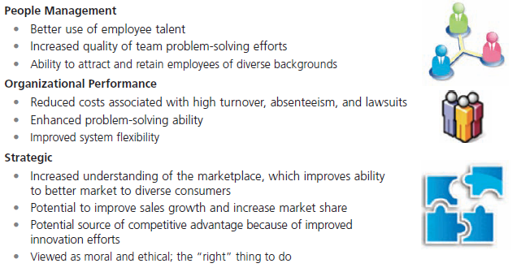
EXHIBIT 4-2 BENEFITS OF WORKFORCE DIVERSITY
Notes:
Many companies are experiencing the benefits that diversity can bring. Exhibit 4-2 looks at why workforce diversity is so important to organizations. The benefits fall into three main categories: people management, organizational performance, and strategic.

Slide 12

THE CHANGING WORKPLACE
Characteristics of the U.S. Population
Total population of the United States projected to increase to 438 million by the year 2050
Racial/ethnic groups - changes in the percentages of the Hispanic and white population
Aging population - median age of 36.9 years up from 36.2 years in 2001
Notes:
Total population of the United States: The total population is projected to increase to 438 million by the year 2050, up from 296 million in 2005; 82 percent of that increase will be due to immigrants and their U.S.-born descendants. Nearly one in five Americans will be an immigrant in 2050, compared with one in eight in 2005.
In addition to total population changes, the components of that population are projected to change as well. The main changes will be in the percentages of the Hispanic and white population. But the data also indicate that the Asian population will almost double The median age of the U.S. population stands at 36.9 years, up from 36.2 years in 2001. By 2050 one in every five persons will be aged 65 or over.

Slide 13
EXHIBIT 4-4 GLOBAL AGING: HOW MUCH DO YOU KNOW?
Notes:
How much do you know about global aging? (Our guess is . . . probably not much!) Take the quiz in Exhibit 4-4—no peeking at the answers beforehand—and see how well you scored.

Slide 14
EXHIBIT 4-4 GLOBAL AGING: HOW MUCH DO YOU KNOW? (CONT.)
Notes:
Are you surprised by some of the answers?

Slide 15
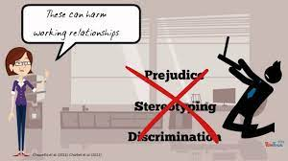
CHALLENGES IN MANAGING DIVERSITY
1. Personal Bias
Bias - a tendency or preference toward a particular perspective or ideology. One outcome of our personal biases can be prejudice - a pre-conceived belief, opinion, or judgment toward a person or a group of people
Notes:
Despite the benefits that we know workforce diversity brings to organizations, managers still face challenges in creating accommodating and safe work environments for diverse employees.
Bias is a term that describes a tendency or preference toward a particular perspective or ideology. It’s generally seen as a “one-sided” perspective. Our personal biases cause us to have preconceived opinions about people or things. Such preconceived opinions can create all kinds of inaccurate judgments and attitudes. One outcome of our personal biases can be prejudice, a preconceived belief, opinion, or judgment toward a person or a group of people. Our prejudice can be based on all the types of diversity we discussed: race, gender, ethnicity, age, disability, religion, sexual orientation, or even other personal characteristics

Slide 16
CHALLENGES IN MANAGING DIVERSITY (CONT.)
A major factor in prejudice is Stereotyping - judging a person based on a prejudicial perception of a group to which that person belongs.
Both prejudice and stereotyping can lead to someone treating others who are members of a particular group unequally. That’s what we call Discrimination - when someone acts out their prejudicial attitudes toward people who are the targets of their prejudice.
2. Glass Ceiling - the invisible barrier that separates women and minorities from top management positions.
Notes:
A major factor in prejudice is stereotyping, which is judging a person on the basis of one’s perception of a group to which he or she belongs. For instance, “Married persons are more stable employees than single persons” is an example of stereotyping. Keep in mind, though, that not all stereotypes are inaccurate. However, many stereotypes aren’t factual and distort our judgment.
Both prejudice and stereotyping can lead to someone treating others who are members of a particular group unequally. That’s discrimination, which is when someone acts out their prejudicial attitudes toward people who are the targets of their prejudice.
In the 1980s, the term glass ceiling, first used in a Wall Street Journal article, refers to the invisible barrier that separates women and minorities from top management
positions. The idea of a “ceiling” means something is blocking upward movement and the idea of “glass” is that whatever’s blocking the way isn’t immediately apparent.

Slide 17

THE LEGAL ASPECT OF WORKPLACE DIVERSITY
Federal laws have contributed to some of the social change we have seen over the last 50-plus years
Workplace diversity needs to be more than understanding and complying with federal laws.
Organizations that are successful at managing diversity use additional diversity initiatives and programs
Notes:
The fact is that federal laws have contributed to some of the social change we’ve seen over the last 50-plus years. Failure to comply with federal laws, can be costly and damaging to an organization’s bottom line and reputation. It’s important that managers know what they can and cannot do legally and ensure that all employees understand as well.
However, effectively managing workplace diversity needs to be more than understanding and complying with federal laws. Organizations that are successful at managing diversity use additional diversity initiatives and programs.

Slide 18
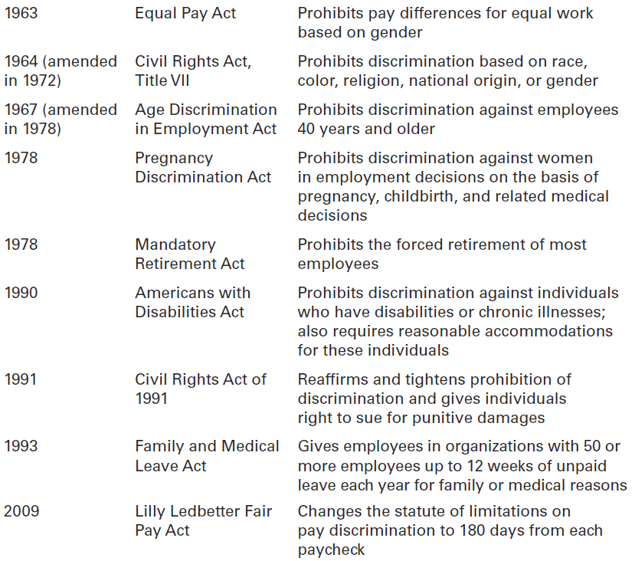
EXHIBIT 4-8 MAJOR EQUAL EMPLOYMENT OPPORTUNITY LAWS
Notes:
Exhibit 4-8 describes the major equal employment opportunity laws with which organizations must comply.

Slide 19
EXHIBIT 4-8 MAJOR EQUAL EMPLOYMENT OPPORTUNITY LAWS (CONT.)

Slide 20

TOP MANAGEMENT COMMITMENT TO DIVERSITY
Mentoring - a process whereby an experienced organizational member (a mentor) provides advice and guidance to a less-experienced member (a protégé).
Diversity Skills Training - specialized training to educate employees about the importance of diversity and to teach them skills for working in a diverse workplace
Notes:
A sustainable diversity and inclusion strategy must play a central role in decision making at the highest leadership level and filter down to every level of the company
Mentoring is a process whereby an experienced organizational member (a mentor) provides advice and guidance to a less-experienced member (a protégé). Mentors usually provide two unique forms of mentoring functions: career development and social support.
The challenge for organizations is to find ways for employees to be effective in dealing with others who aren’t like them. Diversity skills training is specialized training to educate employees about the importance of diversity and teach them skills for working in a diverse workplace

Slide 21
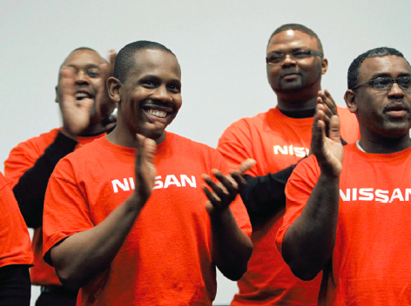
TOP MANAGEMENT COMMITMENT TO DIVERSITY (CONT.)
Employee Resource Groups - groups made up of employees connected by some common dimension of diversity.
Notes:
Employee resource groups are made up of employees connected by some common dimension of diversity. Such groups typically are formed by the employees themselves, not the organizations. However, it’s important for organizations to recognize and support these groups.

Slide 22

ANY QUESTION?

Slide 23

END OF LESSON

